Slide 1
Pappus: Plants and Play Promoting Universal Skills
Botany Basics

Slide 2
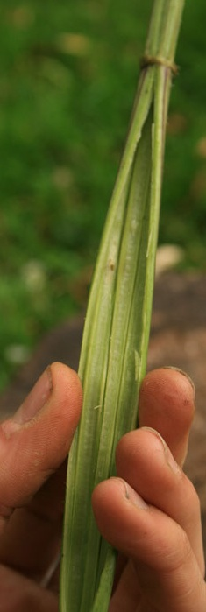
What do we mean by plants?
Plants are:
Trees, shrubs, herbs, grasses, ferns, and mosses...
Associated plant features include:
The fruit, bulb, flower, leaves, stem, roots, cells…
Playful plants and learning supported by plants
Fun
Survival
Medicinal
Cookery
Textiles
Bushcraft
Loose Parts Resources
History
Technology
Design
Language
Maths
Literacy
Science!
Notes:
FELICITY

Slide 3
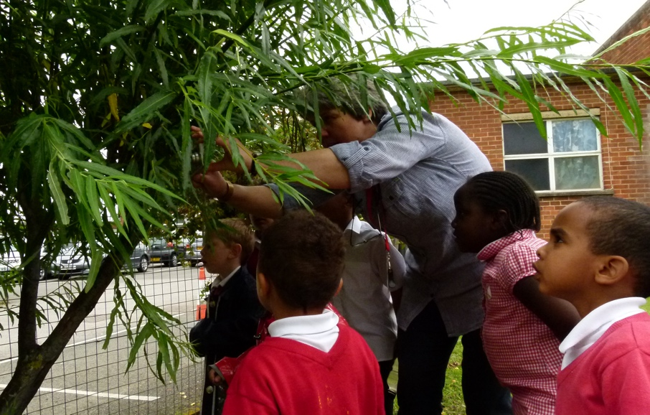
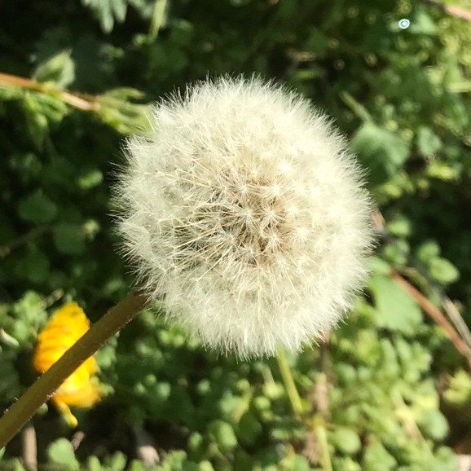
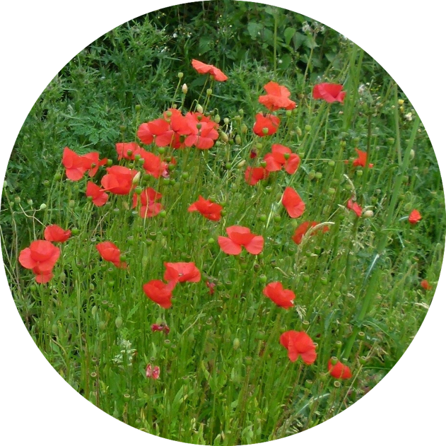
Which plants? The Pappus ‘top 15 plants’
Ash
Blackberry
Conifer
Dandelion
Dog Rose
Elder
Grasses
Hazel
Horse Chestnut
Ivy
Lime
Nettle
Oak
Poppy
Willow
Notes:
KELLY
How we got to the PAPPUS 15

Slide 4
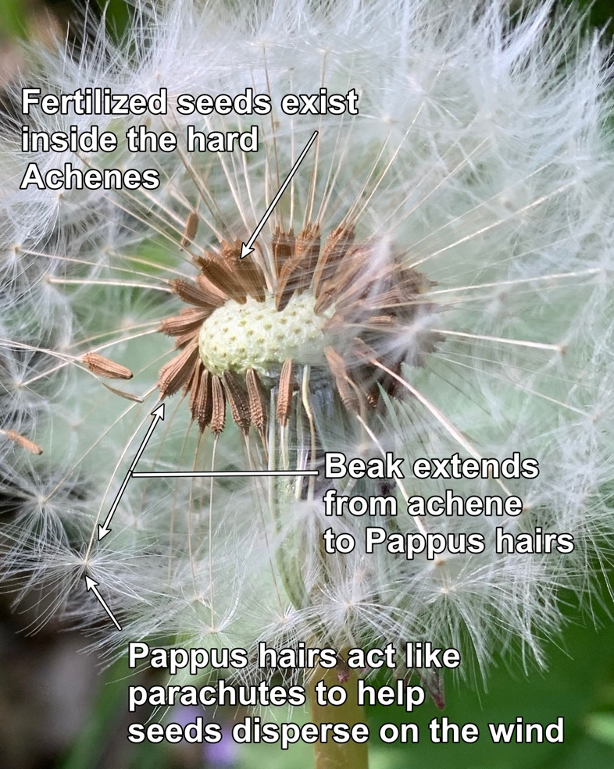
Why use the plant ID sheets?
Build confidence in handling plants and recognisng the common parts of a plant
Encourage immersive and patient observational skills, sometimes using all five senses
Observe and comment on natural patterns and behaviors
Suggest how to examine plants in detail
Notes:
JULES

Slide 5
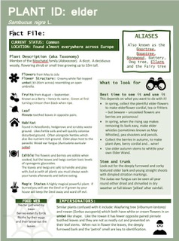
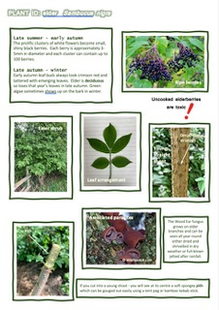
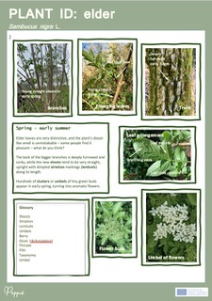
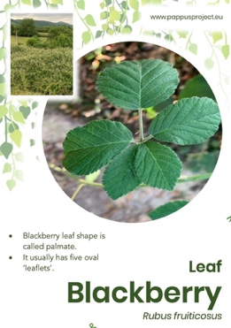
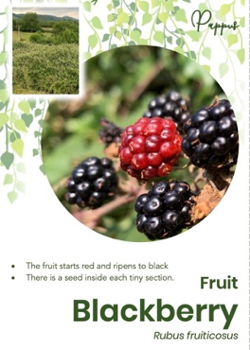
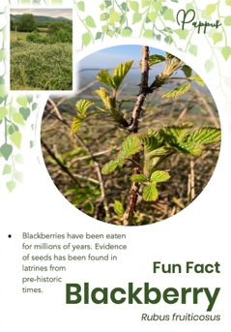
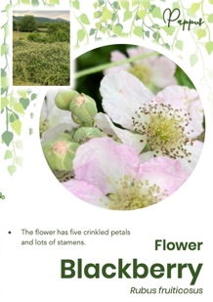
Plant identification (ID) fact sheets
A connection to cultural stories and uses of key commons plants
Experience the work of a botanist or other plant scientist
15 focused plant ID. sheets and virtual eco-tutor films on the Pappus YouTube channel
Notes:
JULES

