Slide 1
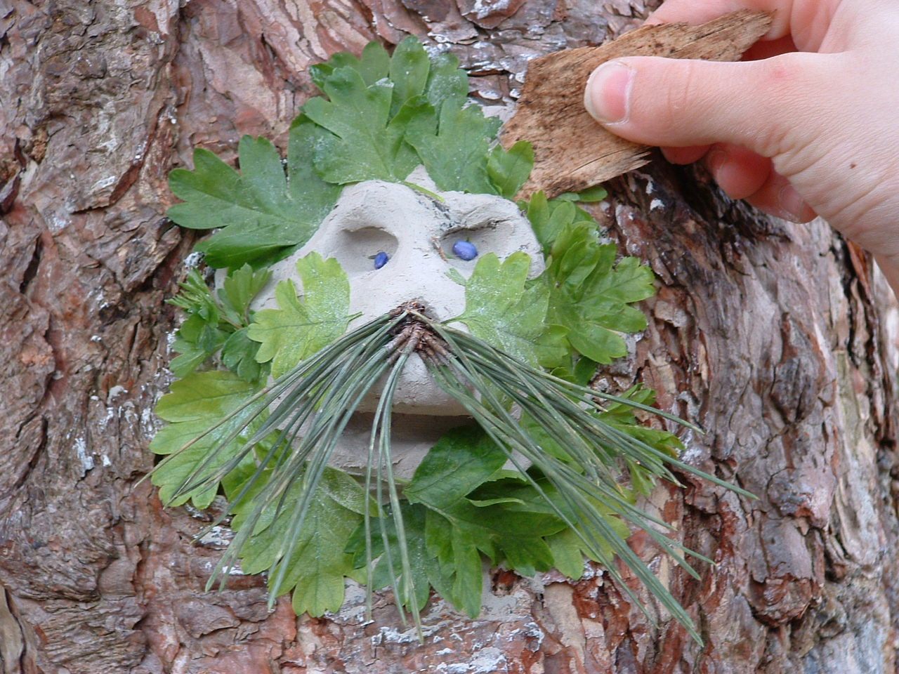
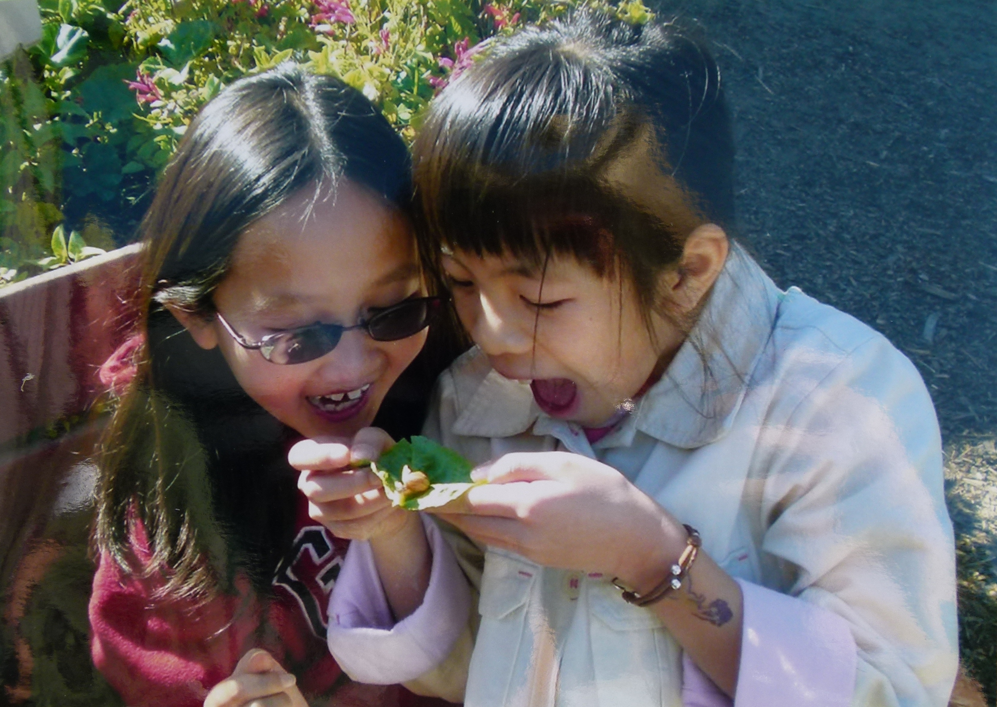
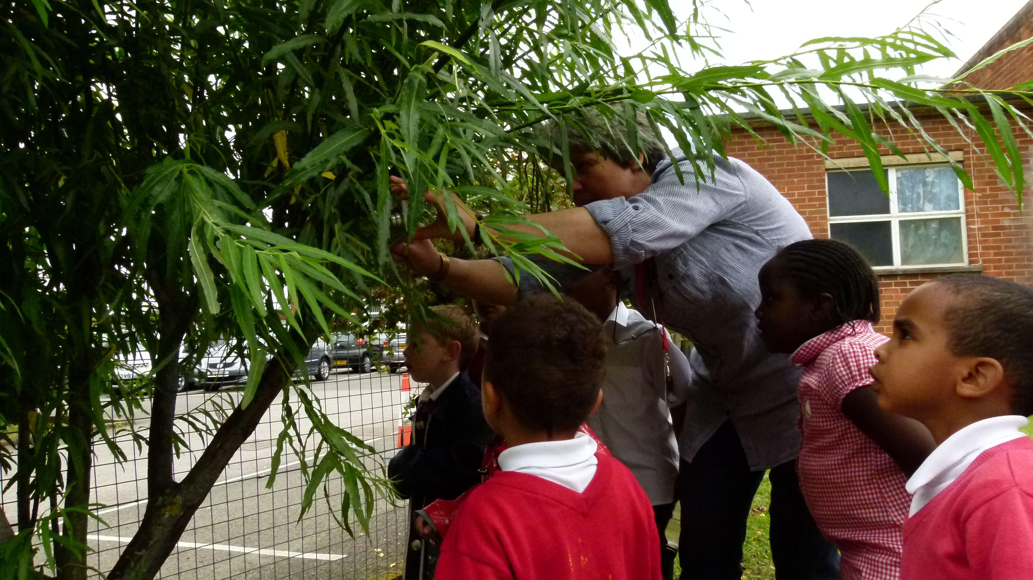
Pappus: plants and play promoting universal skills
Pappus aims to develop young people’s skills and competencies through playful engagement in the natural world of botany and horticulture
Notes:
Speaker notes:
Pappus was funded by the EU’s Erasmus+ programme, and is a partnership between six European countries:
England
Austria
Hungary
The Czech Republic
Poland
Slovakia
The programme aims to encourage schools to incorporate plants into the curriculum in a playful way, and has researched hundreds of learning and play ideas to provide springboards for learning and play, that will work with any European curriculum from age 9 through to 14.
There are three key elements to the Pappus materials, all of which can be accessed freely on the Pappus website:
Learning Springboards, including ID and information sheets for the Pappus ’Top 15’ plants
Play Springboards, a set of ideas for each of the Pappus Top 15 plants
Training materials for teachers – with two routes, either self-directed or tutor led.

Slide 2
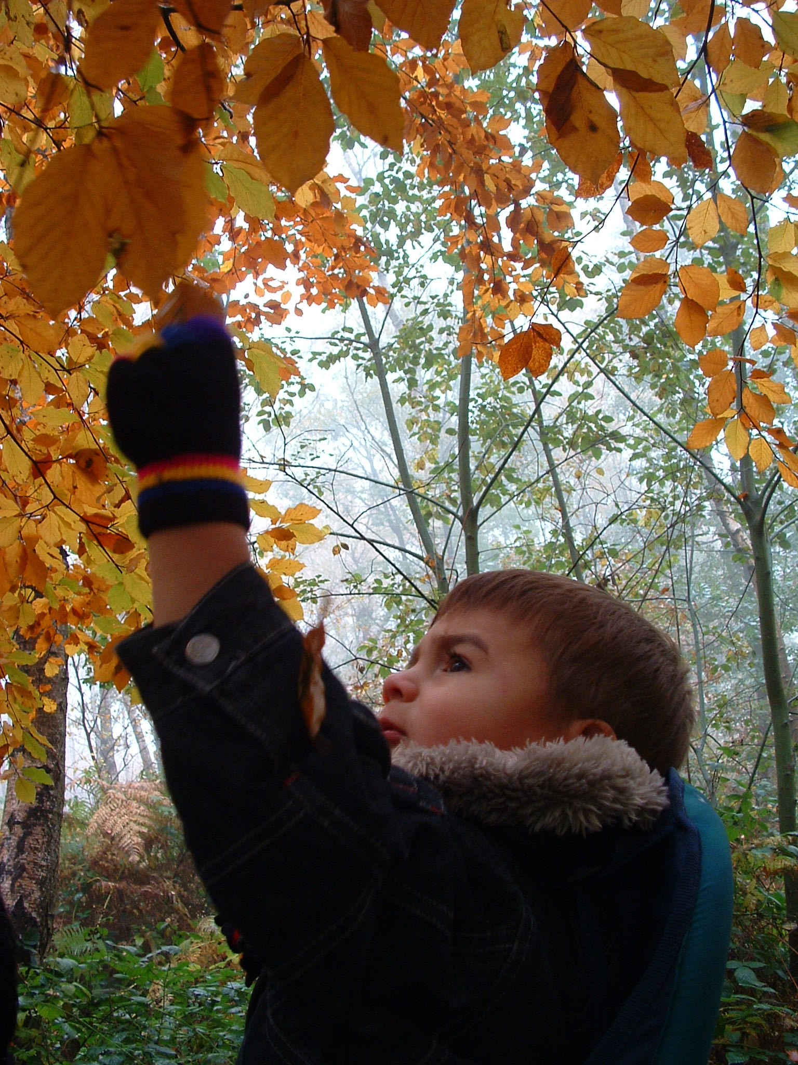
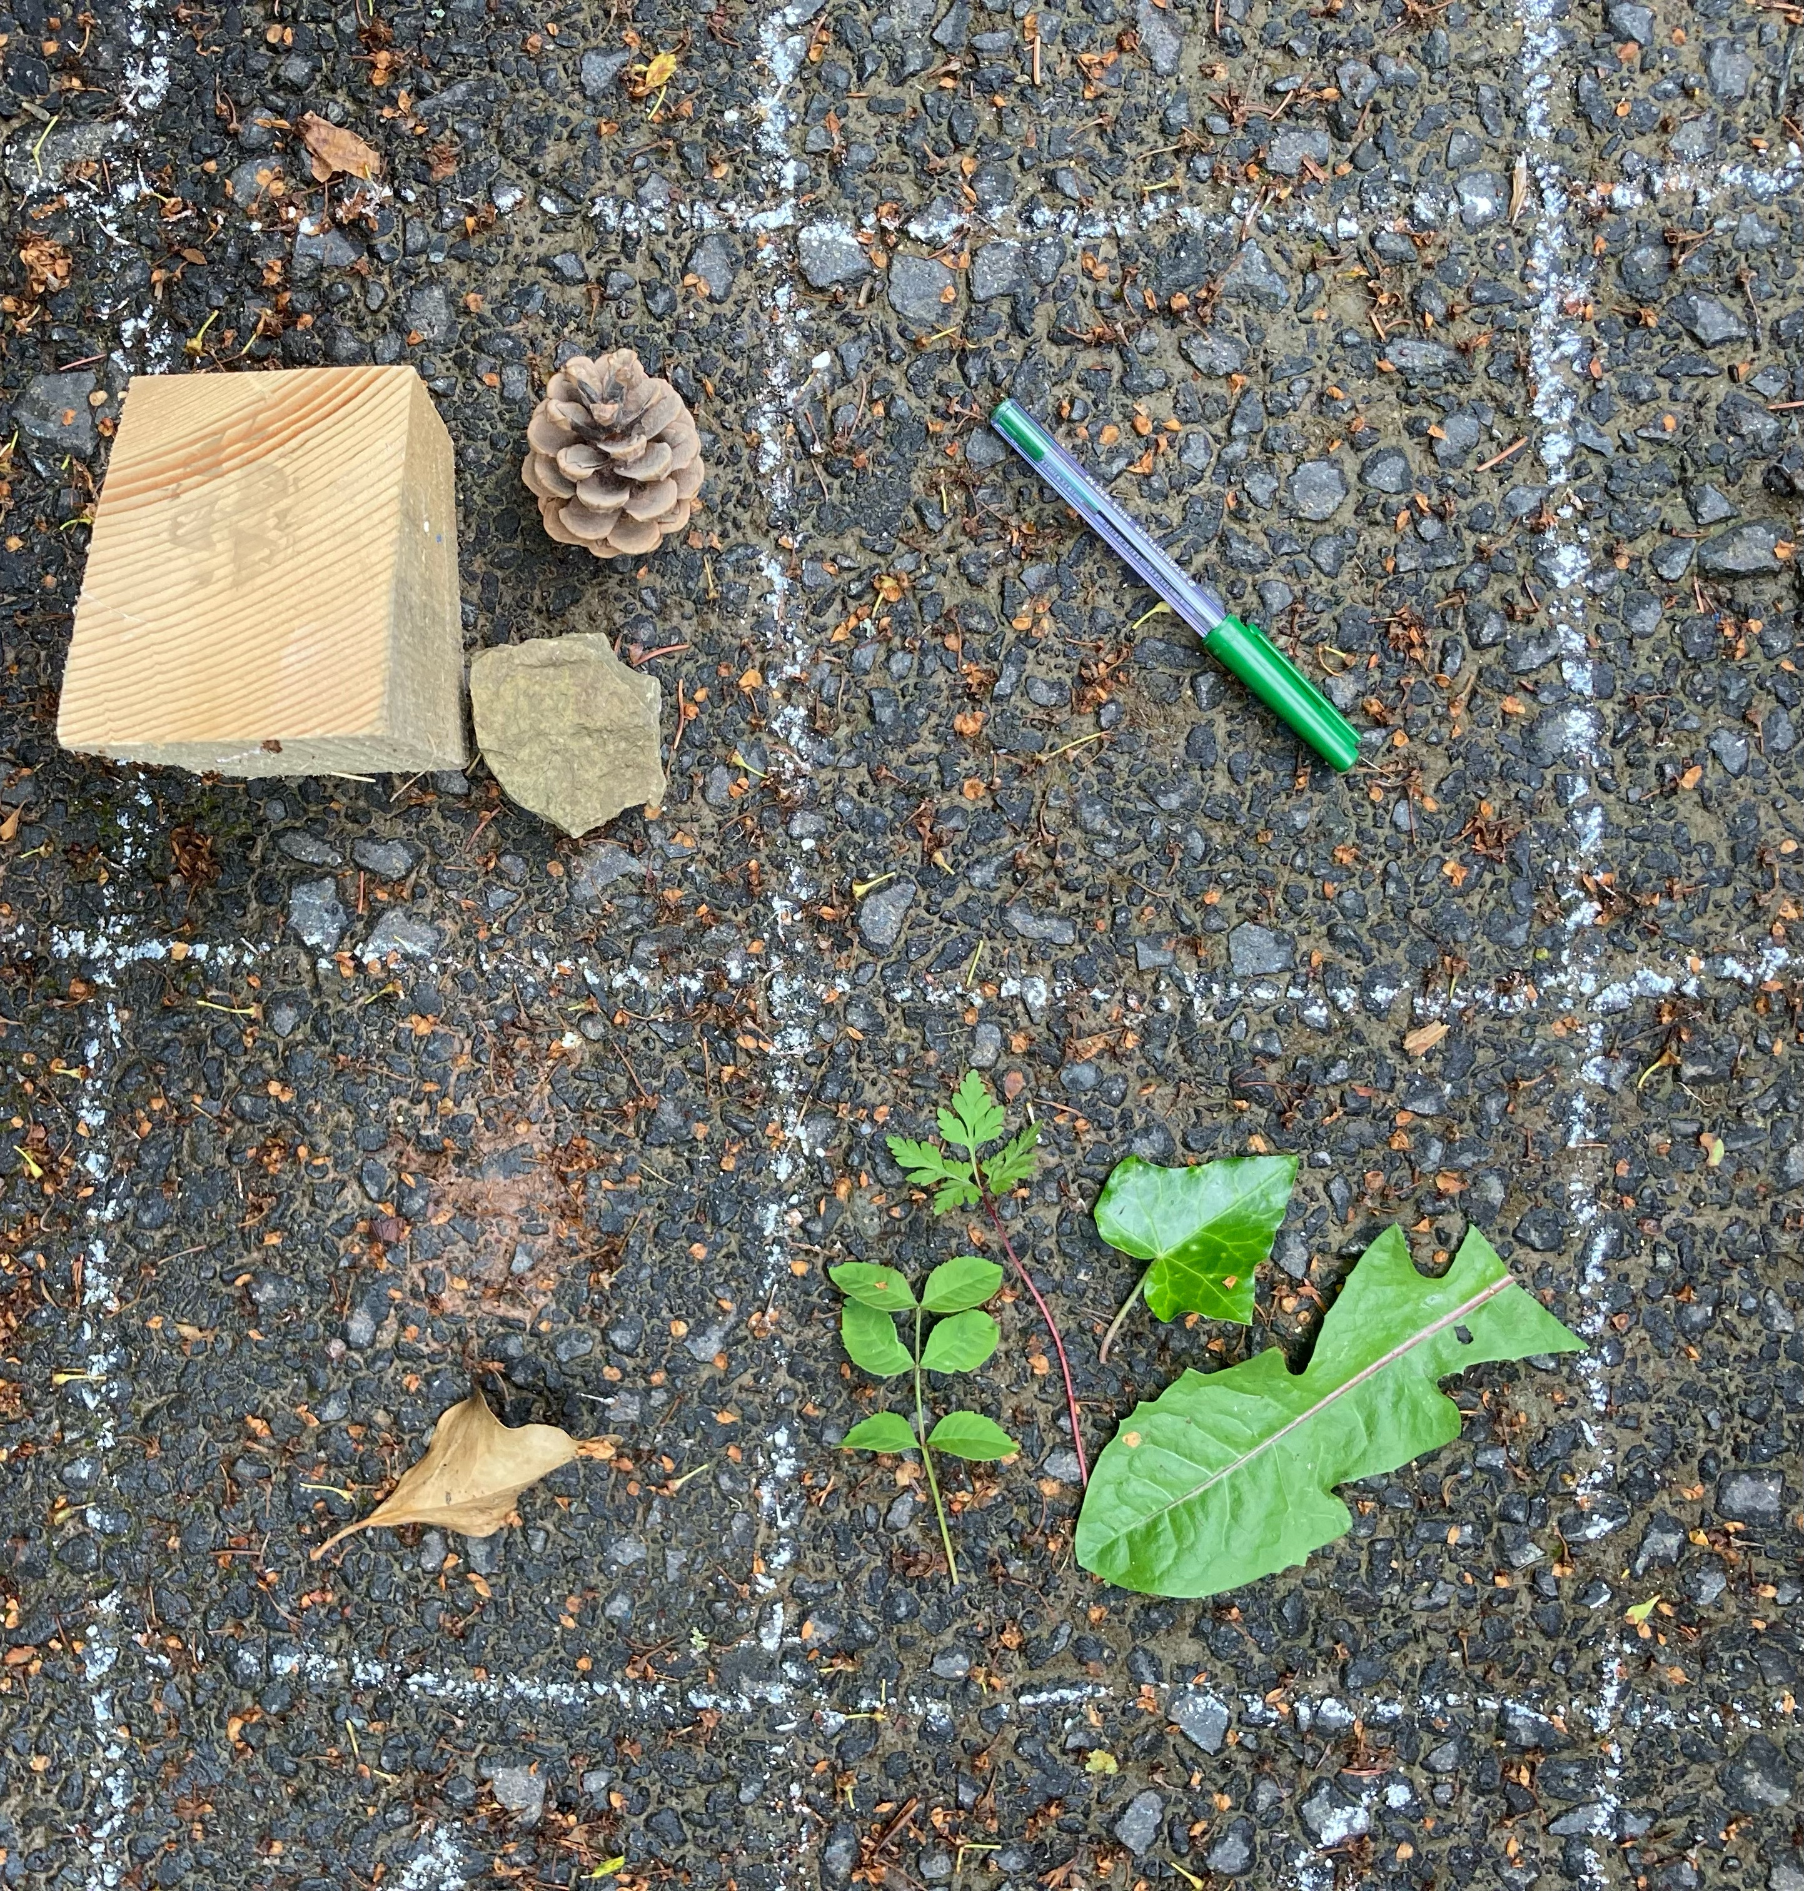
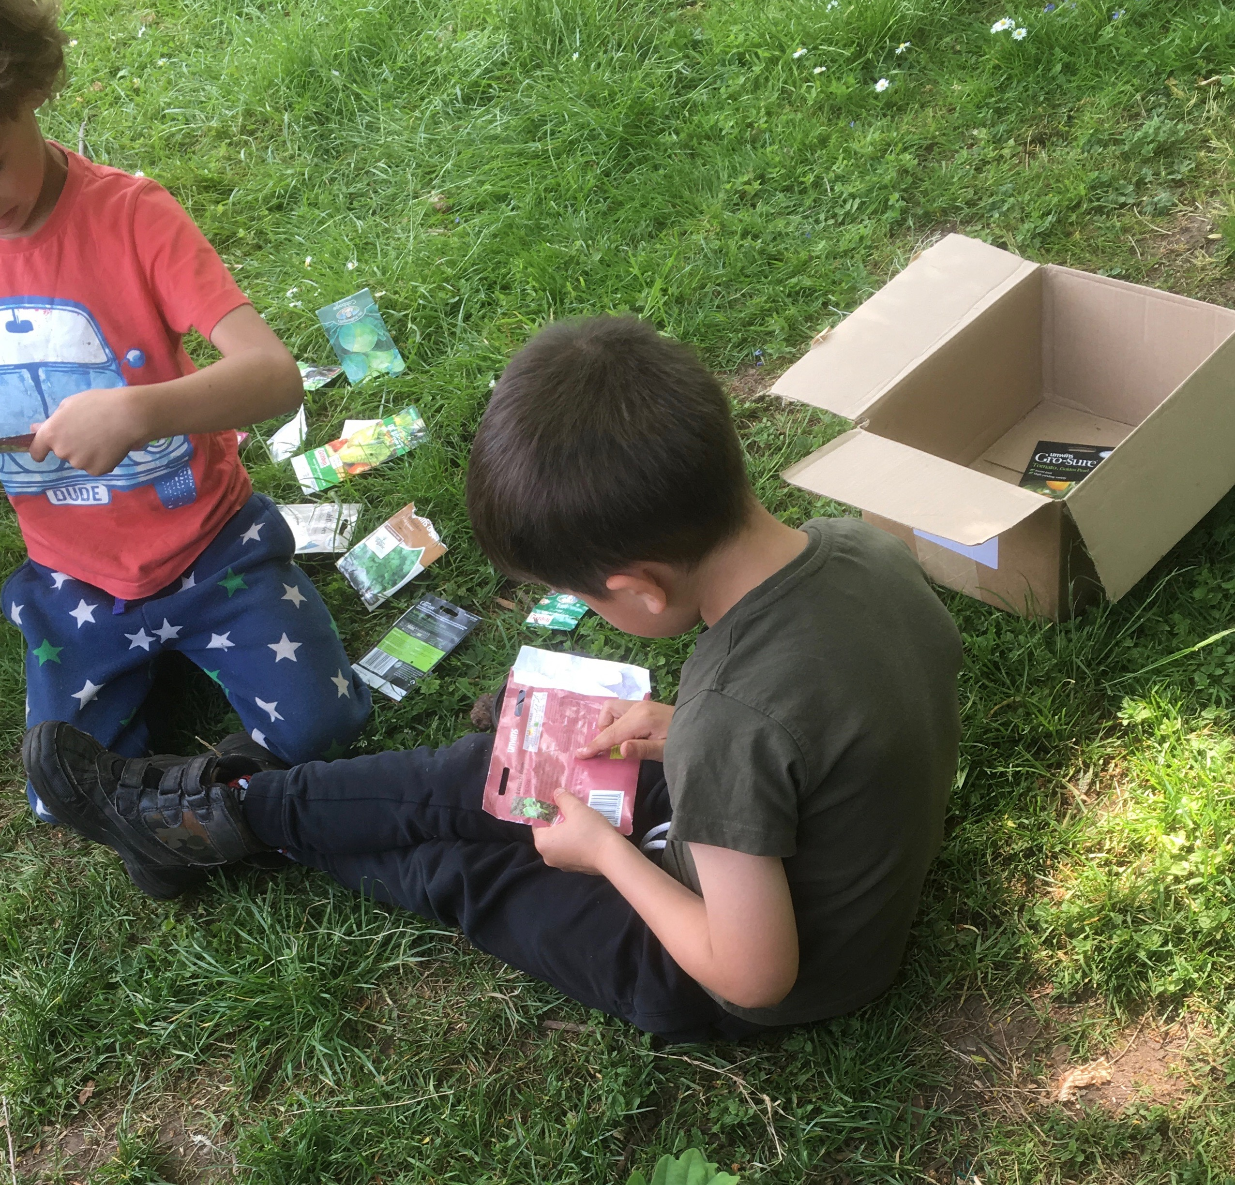
Why learn outdoors and with plants?
Purposeful and memorable real-world learning interactions
Developing an appreciation and understanding of the natural world
Impact on health and well-being
Concentration
Fun and the excitement of discovery
Notes:
Speaker notes:
ACADEMIC ACHIEVEMENT: Learning and playing outdoors has long been understood to have immediate and longer term benefits for children and young people. As far back as 2010, Ofsted in England recognised that learning beyond the classroom is memorable and aids retention of learning, and that children find these ‘real world’ experiences meaningful and purposeful compared to in-class learning.
ENVIRONMENTAL UNDERSTANDING: The climate crisis will be solved by today's children and young people – but we cannot expect them to even care if they know little and have no connection with their own immediate environment. Schools as well as families have a responsibility to educate children and enable them to care sufficiently to act. Many children and young people are inspired by the work of their peers such as Greta Thunberg and by key figures such as Sir David Attenborough; the school grounds and the immediate locality are the perfect place to being this journey of understanding and accountability.
HEALTH AND WELLBEING: Being outdoors and being physically active are good for children’s health and wellbeing; children and young people should be engaging in 180 minutes of physical activity every day [source: British Hearth Foundation / NHS / Department for Health]. Physical movement boosts oxygen levels and movement and cognition are intrinsically linked, building lasting neurological connections as well as supporting longer periods of sustained concentration. Sedentary behaviours lead to serious health complications including obesity and diabetes, even in young children: taking learning outdoors regularly and frequently can help counteract these behaviours.
ATTENTION AND MOVEMENT: For many children, staying still is the most difficult skill; the child that can’t stay still needs more movement, not less – so taking learning outdoors helps all children, but particularly those who find sitting indoors and listening most challenging. Where being indoors might create or sustains stress, anxiety or aggression, being outdoors can be the ‘escape valve’ that enables these children to reset and adapt and learn in an environment that poses no threat to their wellbeing.
INDEPENDENCE AND JOY: Being outdoors, playing and learning in the natural environment is unique and special and different to their indoor counterparts. When we take children outdoors, we offer them the excitement of independent discovery, self-directed learning and freely chosen play. They enjoy the space to move and make noise; the time to reflect and to physically interact with natural objects and materials. More than 50% of the global population lives in urban environments – making access to green school grounds even more vital to the healthy growth of children and young people.

Slide 3
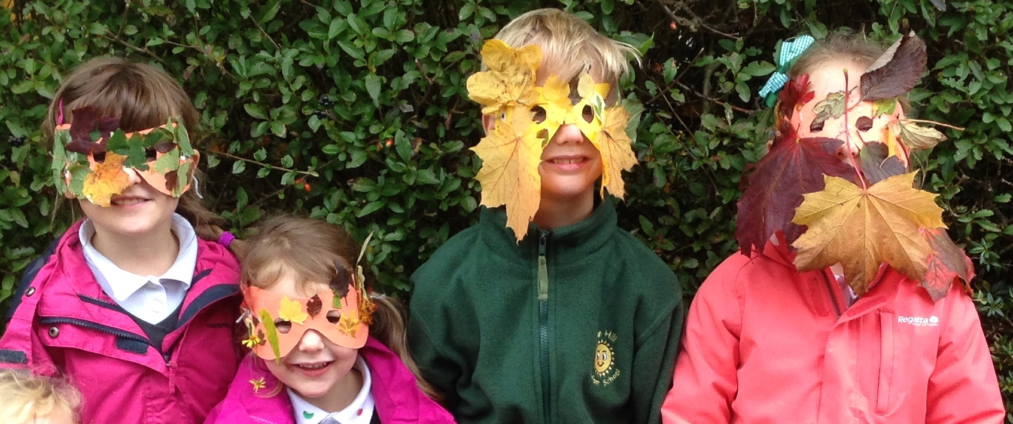
Why ‘playful’?
Playful learning is memorable learning – and play is the way children learn.
Children interact and respond differently to stimuli in playful learning compared to ‘typical’ adult led learning.
“We don’t stop playing because we grow old; we grow old because we stop playing.” George Bernard Shaw – playwright
“…combinatory or associative play seems to be the essential feature in productive thought.” Albert Einstein. - scientist
Notes:
Speaker notes:
From birth, play is the way humans and other mammals learn. Children and adults observe and imitate, we experiment, we test boundaries, we innovate and we learn from mistakes in order to build skills and knowledge. For some reason as we get older, we no longer associate these actions and reactions with ‘play’ – and yet, that’s absolutely what it is.
Pappus focused on playfulness because that’s the approach that’s most likely to engage children and young people, reinforce learning outcomes and drive exploration. Being outdoors feels naturally more ‘free’ and less constraining than even the most state of the art classroom, so whilst not all of the Pappus activities take place entirely outdoors, they do all require specimens of plants, ideally collected by children themselves.
Pappus centres on a ‘Top 15’ of common plants, so that enabling children to collect the necessary specimens, is as straightforward as possible.

Slide 4
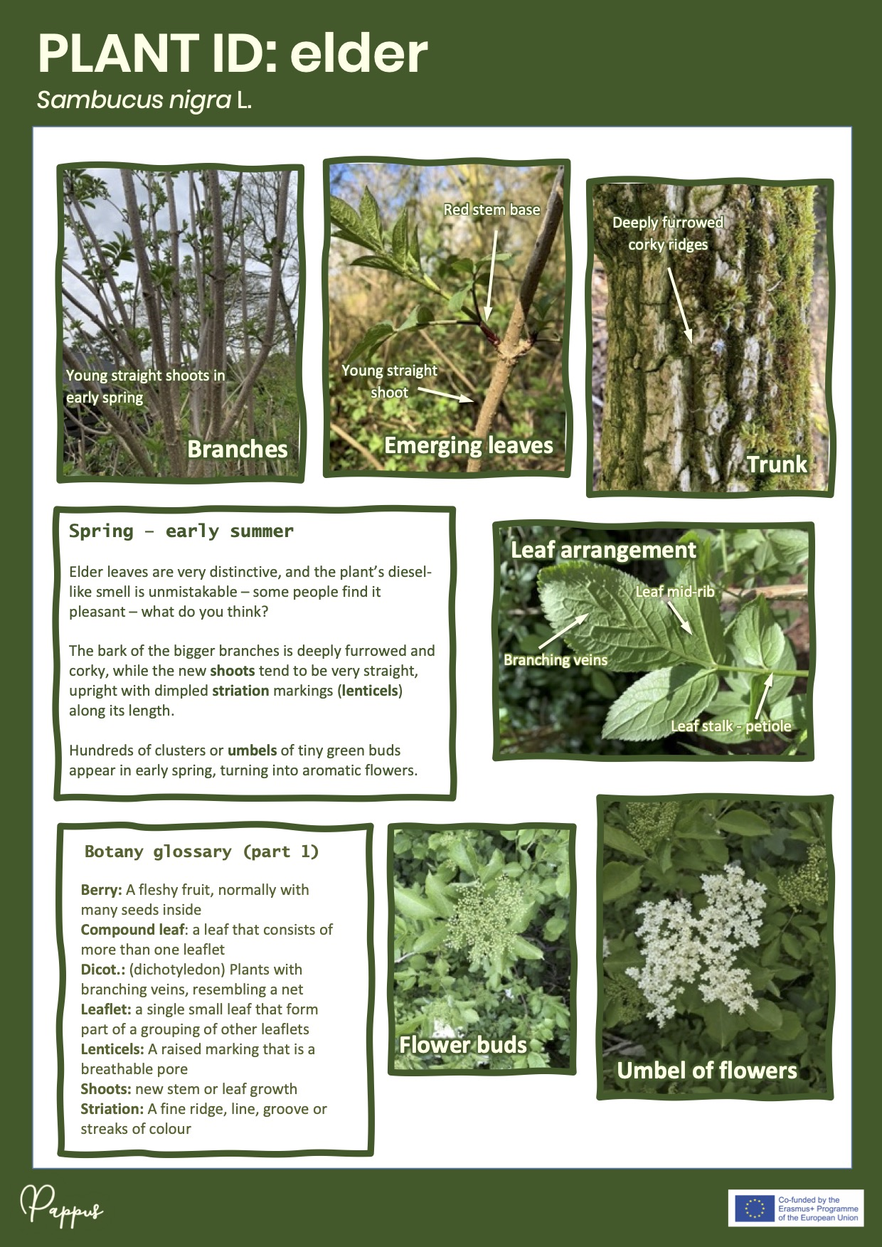
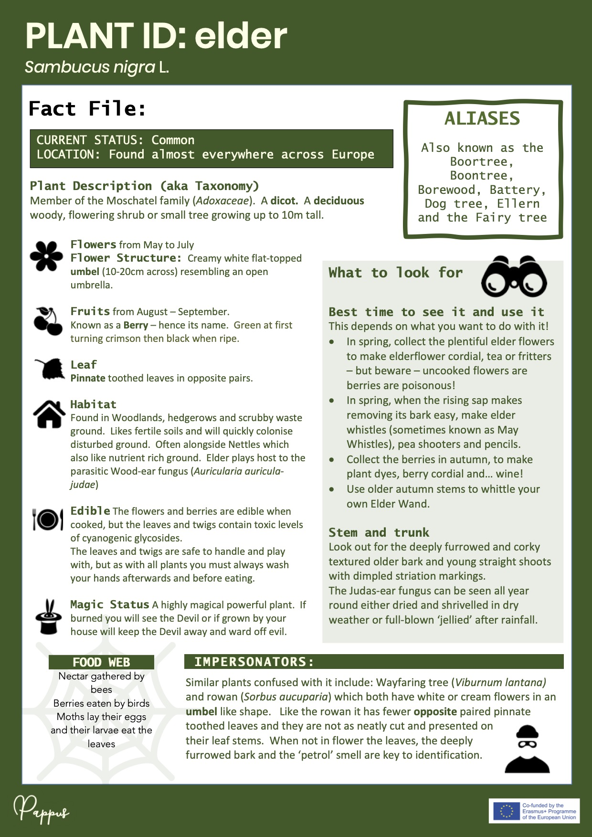
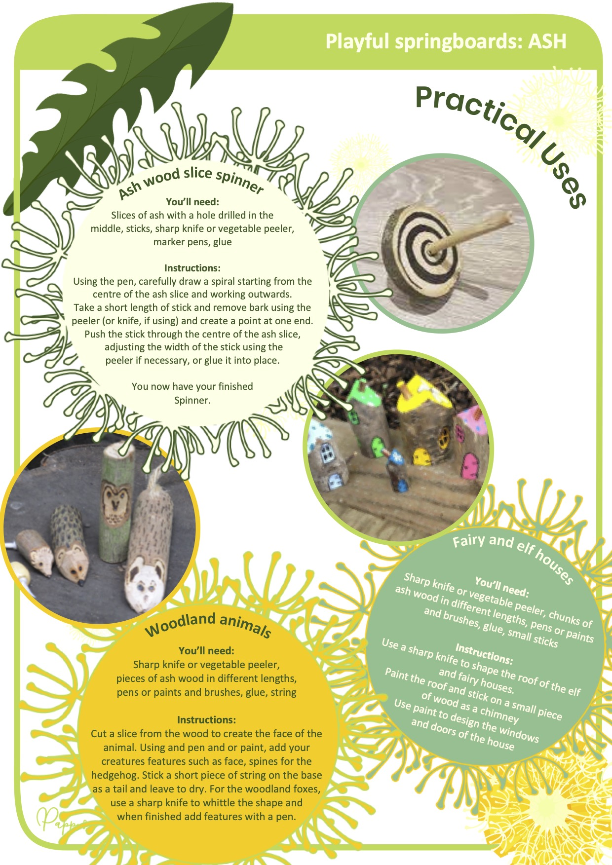
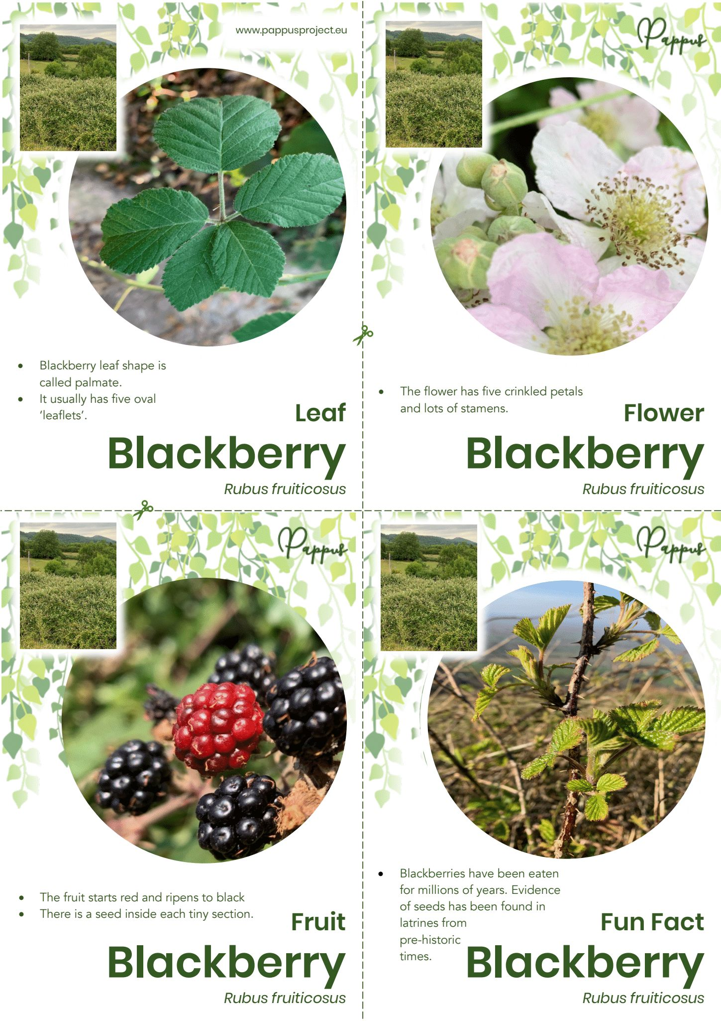
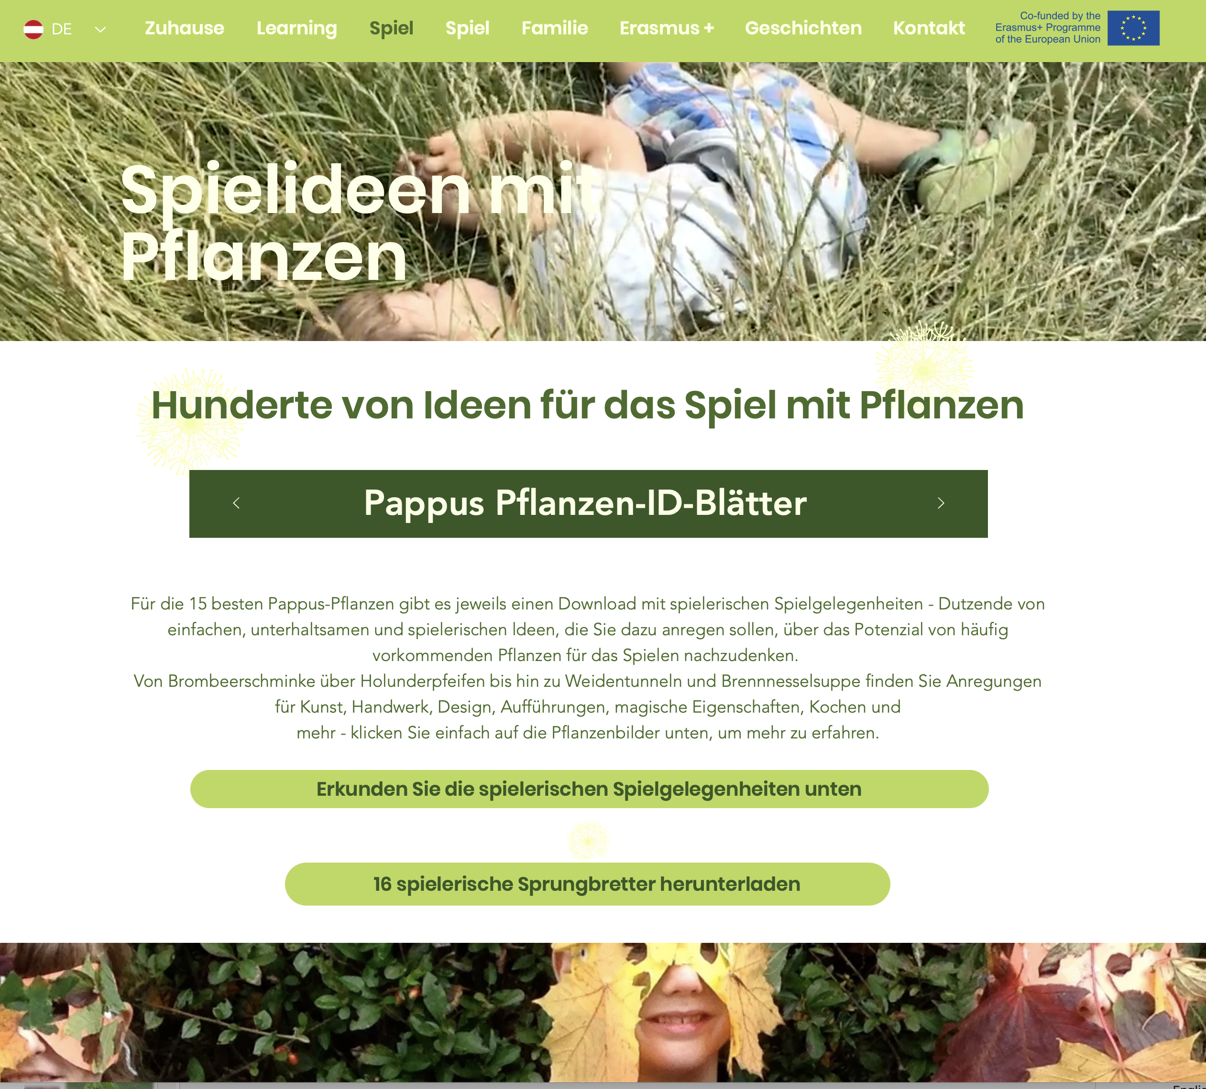
Using the Pappus resources
Notes:
Speaker notes:
Funded by the EU’s unique education programme, Erasmus+, the huge and comprehensive Pappus resource bank is free to access:
LEARNING SPRINGBOARDS: Hundreds of ideas for learning, from quick and simple activities through to in-depth examinations of curriculum areas, topics or skills. There are nine curriculum subjects covered, many with cross curricular links (e.g. how Shakespeare uses botanical metaphors) and each set of learning springboards can be downloaded individually or as a set.
PLAY SPRINGBOARDS: Each of the Pappus Top 15 plants has a set of play springboards with ideas to encourage children and families to get active with plants outdoors – ideas range from games and recipes to myths and stories and creative arts projects.
DETAILED PLANT ID SHEETS FOR LEARNERS: 15 plants illustrated clearly and in detail, along with information about plant uses, history and myths associated with them, what to look out for, pests and diseases, glossary terms and much more.
LANGUAGES AND CULTURAL REFERENCES: the Pappus website and ALL of its downloadable resources can be accessed in German, Hungarian, Slovakian, Czech and Polish, and many of the materials available have been developed by the Pappus partners and reflect their own significant national, regional and culturally important plants.
CPD FOR TEACHERS: the self-directed Pappus CPD programme is aimed at teachers wanting to develop their own knowledge of plants and how to use them as an inspirational teaching resource.

